Slide 1
Smart water fountains

Slide 2

SMART WATER FOUNTAIN
Smart water fountains are innovative devices combine water filtration with advanced technology. They offer touchless, hands-free operation and often feature sensors for user interaction and maintenance alerts. Connectivity options enable remote monitoring, data analytics, and customization. These fountains are ideal for environments like offices and public spaces, promoting water quality, hygiene, and sustainability. They also encourage the use of reusable containers, reducing the need for single-use plastic bottles.

Slide 3
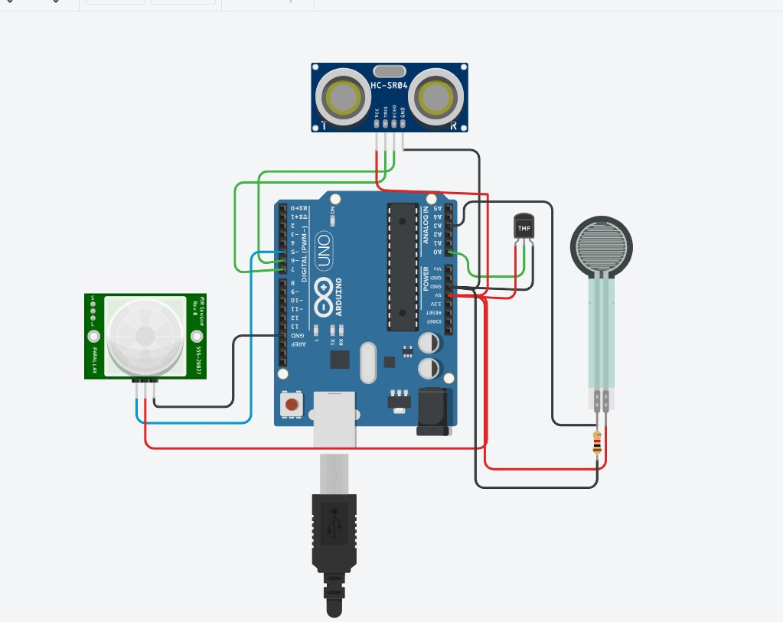
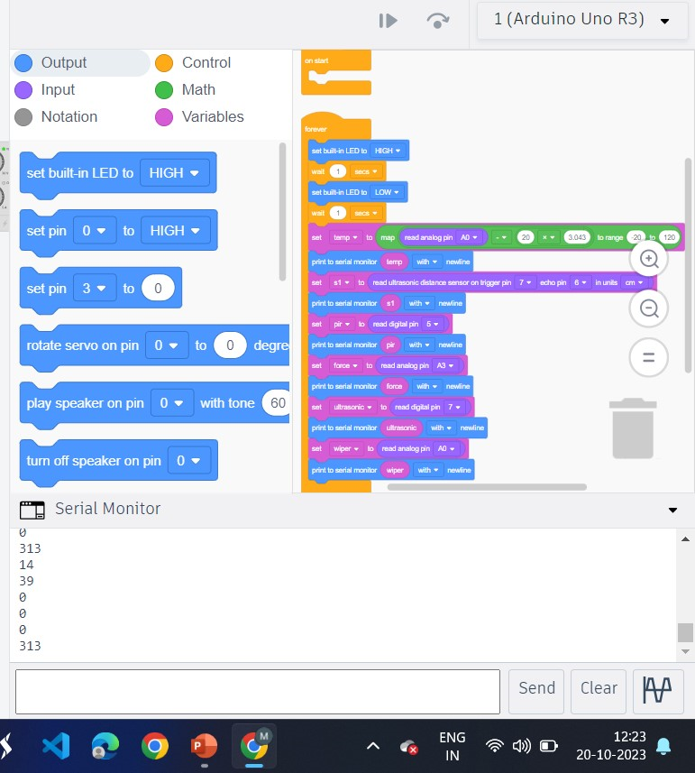
TINKERCAD

Slide 4
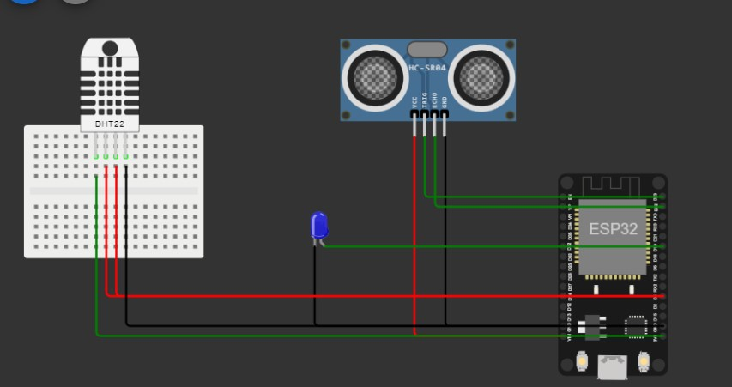
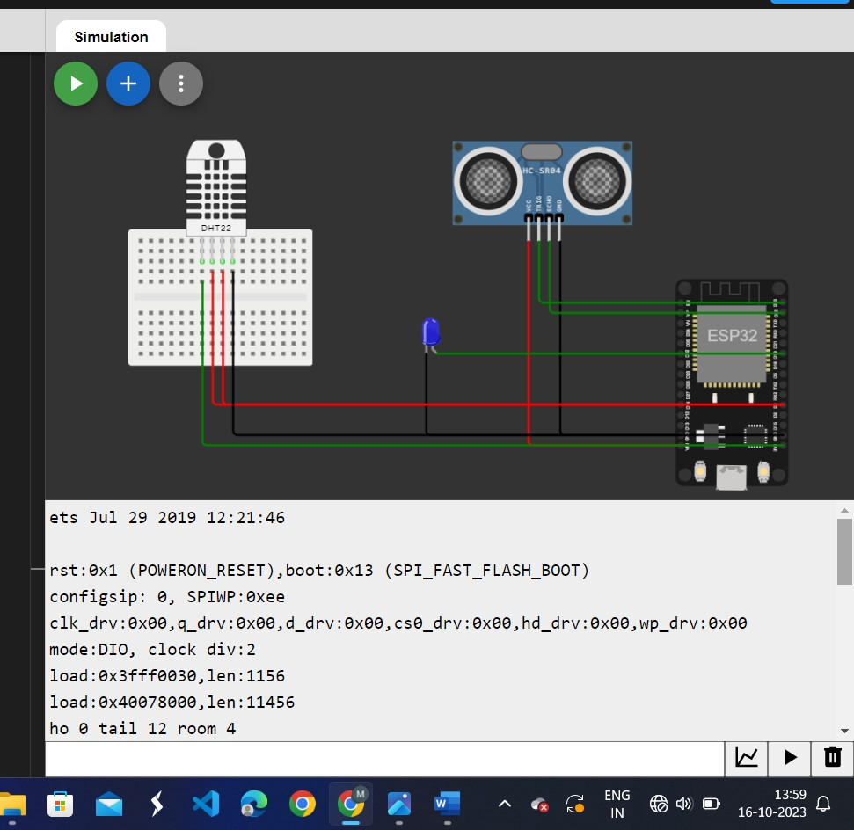
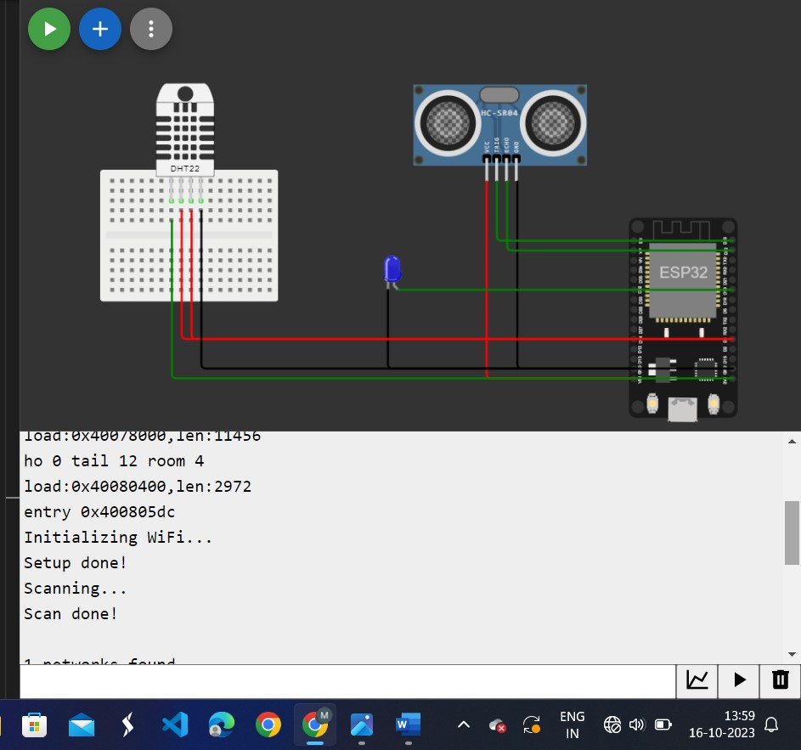
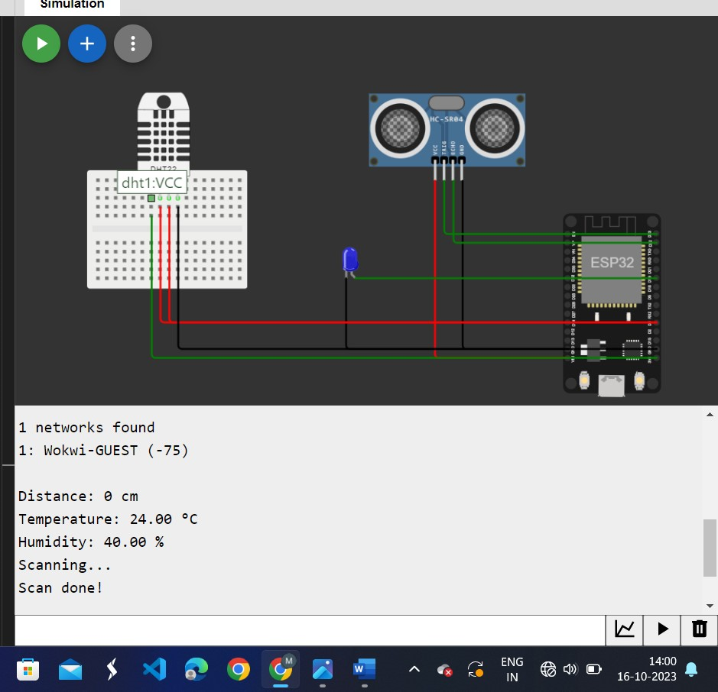
wokwi

Slide 5
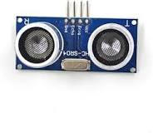
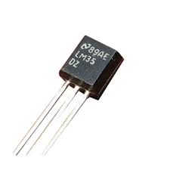
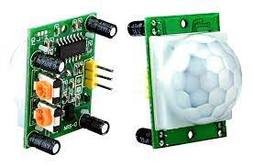
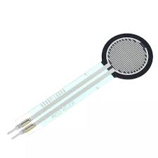
ULTRASONIC SENSOR
An ultrasonic sensor is an instrument that measures the distance to an object using ultrasonic sound waves. An ultrasonic sensor uses a transducer to send and receive ultrasonic pulses that relay back information about an object's proximity
TEMPERATURE SENSOR
A temperature sensor is a device used to measure temperature. This can be air temperature, liquid temperature or the temperature of solid matter. There are different types of temperature sensors available and they each use different technologies and principles to take the temperature measurement.
PIR SENSOR
A passive infrared sensor (PIR sensor) is an electronic sensor that measures infrared (IR) light radiating from objects in its field of view. They are most often used in PIR-based motion detectors. PIR sensors are commonly used in security alarms and automatic lighting applications.
FORCE SENSOR
A force sensor is a device that measures applied force or load. It can be in the form of strain gauges, piezoelectric elements, or other technologies. Force sensors find applications in fields such as robotics, industrial automation, and material testing.

Slide 6
PROGRAM
ULTRASONIC SENSOR
import machine
mport time
# Pin assignments for the ultrasonic sensor
TRIGGER_PIN = 23 # GPIO23 for trigger
ECHO_PIN = 22 # GPIO22 for echo
# Pin assignment for the LED
LEAK_LED_PIN = 19 # GPIO19 for the LED
# Set the pin modes
trigger = machine.Pin(TRIGGER_PIN, machine.Pin.OUT)
echo = machine.Pin(ECHO_PIN, machine.Pin.IN)
leak_led = machine.Pin(LEAK_LED_PIN, machine.Pin.OUT)
# Function to measure distance using the ultrasonic sensor
def measure_distance():
# Generate a short trigger pulse
trigger.value(0)
time.sleep_us(5)
trigger.value(1)
time.sleep_us(10)
trigger.value(0)
# Measure the echo pulse duration to calculate distance
pulse_start = pulse_end=0
while echo.value() == 0:
pulse_start = time.ticks_us()
while echo.value() == 1:
pulse_end = time.ticks_us()
# Calculate distance in centimeters (assuming the speed of sound is 343 m/s)
distance = (pulse_duration * 0.0343) / 2 # Divide by 2 for one-way travel
# Set the threshold distance for detecting a leak (adjust as needed)

Slide 7
threshold_distance = 10 # Adjust this value based on your tank setup
if distance < threshold_distance:
# If the distance is less than the threshold, a leak is detected
return True
else:
return False
# Main loop
while True:
if check_for_leak():
# Blink the LED to indicate a leak
leak_led.value(1) # LED ON
time.sleep(0.5)
leak_led.value(0) # LED OFF
time.sleep(0.5)
else:
leak_led.value(0) # LED OFF
time.sleep(1) # Delay between measurements
TEMPERATURE SENSOR
import Adafruit_DHT
# Set the sensor type, DHT22 or DHT11
sensor = Adafruit_DHT.DHT22
# GPIO pin where the data pin of the sensor is connected
pin = 4 # Change this to the appropriate GPIO pin on your Raspberry Pi
try:
:# Try to grab a sensor reading.
humidity, temperature = Adafruit_DHT.read_retry(sensor, pin)
if humidity is not None and temperature is not None:
print(f"Temperature: {temperature:.1f}°C")
print(f"Humidity: {humidity:.1f}%")
else:
print("Failed to retrieve data from the sensor. Check your connections.")
except Exception as e:
print(f"Error: {str(e)}")

Slide 8
EPS32 wifi module
import network
import urequests
# WiFi configuration
SSID = "Your_SSID"
PASSWORD = "Your_Password"
# URL to fetch data from
URL = "http://example.com" # Replace with the actual URL
# Connect to WiFi
sta_if = network.WLAN(network.STA_IF)
sta_if.active(True)
sta_if.connect(SSID, PASSWORD)
# Wait until the ESP32 is connected to the WiFi network
while not sta_if.isconnected():
pass
print("Connected to WiFi")
# Fetch data from the specified URL
try:
response = urequests.get(URL)
if response.status_code == 200:
print("HTTP Status Code 200: OK")
print("Content:")
print(response.text) else:
print(f"HTTP Status Code {response.status_code}")
except Exception as e:
print("An error occurred:", e)
finally:
response.close()

Slide 9
THANK YOU

